Slide 1


AI编译器-系列之PyTorch
AOT AutoGrad
ZOMI

Slide 2
Talk Overview
PyTroch 2.0 新特性
2.0 新特性回顾
PyTorch 2.0 安装与新特性使用
PyTorch 2.0 对厂商的启发和思考
TorchDynamo 解读
TorchDynamo 特性
TorchDynamo 实现方案
AOTAutograd 解读
AOTAutograd 效果
AOTAutograd 实现方案
TorchInductor 新特性
Triton 使用解读
Triton 深度剖析

Slide 3
Talk Overview
AOTAutograd 解读
AOTAutograd 实现方案
AOTAutograd 效果
Torch dispatch 机制和原理

Slide 4
TorchDynamo
TorchDynamo hooks into the frame evaluation API in CPython to dynamically modify Python bytecode right before it is executed.
It rewrites Python bytecode in order to extract sequences of PyTorch operations into an FX Graph which is then just-in-time compiled with an ensemble of different backends and autotuning.

Slide 5
Adding Training in TorchDynamo
Training adds challenges because the PyTorch Automatic Differentiation engine sits below the PyTorch dispatcher in C++. Therefore, the operators running in the backward pass are not directly visible to TorchDynamo at the Python level.

Slide 6
Adding Training in TorchDynamo
To support training with TorchDynamo, we need to run/optimize operations that happen in the .backward() pass. Supporting backwards can be done in a few different ways:
Eagerly: backends could use the dynamic autograd tape on every call, the same as eager mode.
TorchScript: Difficult to maintain and does not support all operations.
AOTAutograd: Records the behavior of the eager dispatcher-based autograd once at compile time. This allows it to capture everything with a simpler and more robust implementation that reuses much more of eager mode autograd. In addition, it allows us to easily make optimization decisions with visibility of both the forwards and backwards graphs.

Slide 7
PyTorch Compiler Mode

Slide 8
Speed Up During Training
Integrate again TorchScript.
a. How do you access the backwards pass?
Using Symbolic Script
a. That Does not have full coverage. cannot capture other transforms like vmap.
Using LazyTensor
a. Not a particularly hackable API.
Write your own auto diff.
a. A lot of work…

Slide 9
AOTAutograd
Use whatever compiler you want for training.
Use the resulting function however you want in you PyTorch training code.
All in Python.

Slide 10
AOTAutograd
AOTAutograd relies on the recently introduced torch_dispatch based tracing mechanism to capture the backward graph ahead of time. Therefore, it reuses the PyTorch core Autograd engine to generate the backward graph.

Slide 11
AOTAutograd
Jointly trace the forwards and backwards using __torch_dispatch__
Partition this joint fw + bw graph into 2 graphs: the forward graph and the backwards graph.
Wrap up the new fw + bw graphs into an autograd. Function that can be used in eager mode.

Slide 12
__torch_dispatch__

Slide 13
How does atuograd work?

Slide 14
How does atuograd work?

Slide 15
How does atuograd work?

Slide 16
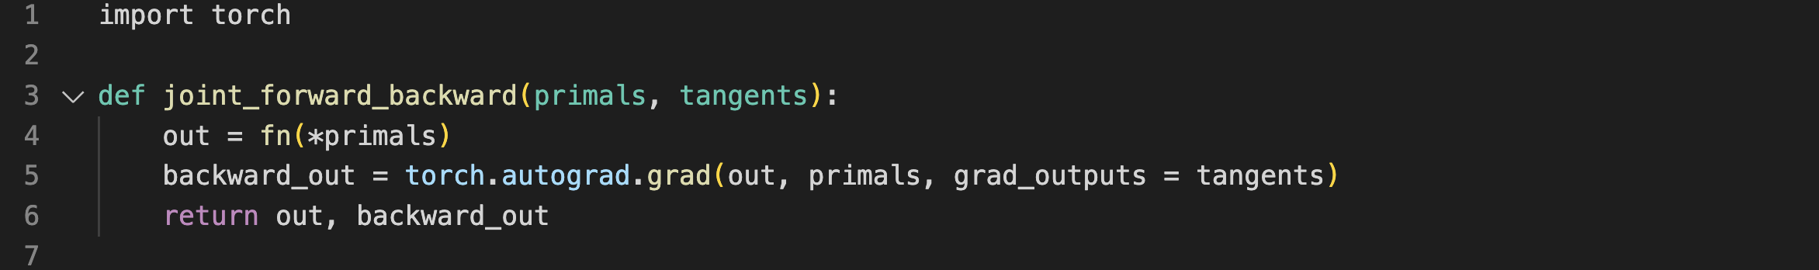
fw + bw graph
The tape base object-oriented realization in Automatic differentiation:

Slide 17
How does atuograd work?

Slide 18
AOTAutograd

Slide 19
Notes:
19

